Slide 1
KeyStone Peripherals Usage
Multicore Training

Slide 2
Agenda
KeyStone II Peripherals and Coprocessors
Resource Management
DSP CorePac CSL Layer
DSP CorePac LLD Layer
LLD Functions
LLD Support in MCSDK 3.x
LLD Usage
NWAL
ARM Kernel Drivers
ARM-DSP Inter-Processor Communications

Slide 3
KeyStone II Peripherals and Coprocessors
KeyStone II Peripherals and Coprocessors
Resource Management
DSP CorePac CSL Layer
DSP CorePac LLD Layer
LLD Functions
LLD Support in MCSDK 3.x
LLD Usage
NWAL
ARM Kernel Drivers
ARM-DSP Inter-Processor Communications

Slide 4
KeyStone I Device Architecture
Memory Subsystem
Application-Specific
Coprocessors
C66x™
CorePac
Miscellaneous
HyperLink
TeraNet
Multicore Navigator
External Interfaces
Network Coprocessor
Notes:
4
NEW

Slide 5
Peripherals and Coprocessors (1/3)
High Bit Rate Interfaces
HyperLink
SRIO
PCIe
10/100/1G SGMII
10G SGMII
USB3
AIF2
TSIP

Slide 6
Peripherals and Coprocessors (2/3)
Low Bit-Rate Interfaces
UART
I2C
SPI
GPIO
IP that support multicore co-operation
Multicore Navigator
EDMA
Semaphore
Timers

Slide 7
Peripherals and Coprocessors (3/3)
Coprocessors
VCP
TCPE
TCPD
FFTC
BCP

Slide 8
Challenges
How to share resources between different cores?
Protect resources from conflict usage
ARM runs Linux, C66x runs BIOS
Solution: Resource Management
How to use these peripherals and IP?
Configuration
Run-time usage
Solution: Chip Support Library (CSL) and Low Level Drivers (LLD) on DSP, LINUX drivers on the ARM

Slide 9
Resource Management
KeyStone II Peripherals and Coprocessors
Resource Management
DSP CorePac CSL Layer
DSP CorePac LLD Layer
LLD Functions
LLD Support in MCSDK 3.x
LLD Usage
NWAL
ARM Kernel Drivers
ARM-DSP Inter-Processor Communications

Slide 10
Resource Management: Background
Initial KeyStone I devices had only DSP cores. The system architect was responsible for resource allocation.
Issues with pre-build libraries and plug-in RTSC modules
Special KeyStone I device that includes an ARM core in addition to DSP
KeyStone I solution – hybrid solution – share resources between DSP and ARM.
ARM resources are defined in the device tree structure
DSP resources manage by the RM LLD
Compatibility with pre-RM code

Slide 11
Keystone I Resource Manager (RM) LLD (1/2)
Prevents DSP applications from stepping on resources taken by ARM Linux
Initialization and usage permissions for select LLD resources defined in user-defined resource table
QMSS, CPPI, and PA LLDs
Operates under the hood of LLDs
Resource init and usage requests made between LLDs and RM directly:
LLD operates normally if resource request is “allowed”
LLD returns error if resource request is “denied”
Application must take steps to handle
Permission tables located in shared memory
Restricts RM to DSP cores only
LLD resource storage still in hands of LLD
Full backwards compatibility with applications not utilizing RM

Slide 12
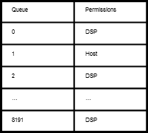
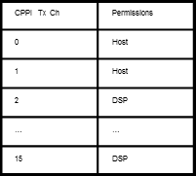
Keystone I Resource Manager (RM) LLD (2/2)
Core 0
Core 1
App
App
Queue/cppiChOpen/ …
Queue/cppiChOpen/ …
Rm_init
QMSS LLD
CPPI LLD
PA LLD
Rm_start
QMSS LLD
CPPI LLD
PA LLD
resource_table.h
rmResourceTable{
{RES_ID, START, END},
{ …, …, … },
…
}
Init/usePermissionCheck
Init/usePermissionCheck
RM
RM
Permission validation
Permission validation
Shared Permissions
Rm_init maps rmResourceTable to internal Permission Tables
…

Slide 13
Keystone I RM: Lessons Learned
Very tedious to add new resources since RM has static definitions in both code and data of resources it manages.
Resource table with privileges defined at compile time.
Privileges cannot be manipulated at runtime
System integrator must align Linux DTB resources with DSP RM resource table.
Tedious and error-prone
Shared memory architecture provides no communication path to ARM.
Not easily portable to new devices

Slide 14
Keystone II RM: Major Requirements
Remove static definitions of managed resources from RM.
Easy addition of new resources
Enable management of resources at all levels within system software architecture.
Core, task, application component (LLD)
Pre/post-main execution
Runtime modification of resource permissions.
Automate reservation of resources taken by Linux kernel.
Generic, processor-independent transport interface that allows RM instances to communicate regardless of device hardware architecture.
Transport glue logic provided by application
Easy to port RM to new devices

Slide 15
Keystone II RM – Overview (1/2)
Instance-based Client/Server Architecture:
Three instance hierarchy:
RM Server – Global management of resources and permission policies
RM Client – Provide resource services to system software elements
RM Client Delegate (CD)
Offloads management of resource subsets from Server.
Provides singular data path to Server
Resource services provided via instance service API
RM Instances Communication Over Generic Transport Interface
Application must setup data paths between RM instances
Allows RM to run on any device architecture without modification to RM source

Slide 16
Keystone II RM – Overview (2/2)
Resources Tracked by RM Defined in Global Resource List (GRL)
GRL captures all resources that will be tracked for a given device
Facilitates automatic extraction of resources used by ARM Linux from Linux DTB
Policies Specify RM Instance Resource Privileges
Resource initialization, usage, and exclusive right privileges assigned to RM instances
Resource assignment to RM instances allows resource management at all software system levels.
Runtime modification of policy privileges
APIs and Linux CLI (Planned)
Resources Stored within Balanced Search Tree Allocators
Reduce memory usage and resource lookup times
Allocators facilitated by NameServer

Slide 17
Keystone II RM: Overview
ARM/DSP n
ARM/DSP n+1
User Mode (ARM)
Resource Policies
Global Resource List (GRL)
Linux DTB
Available resources are inverse of Linux DTB
Memory Allocator
QMSS
CPPI
RM Server Instance
RM CD Instance
QMSS
Allocation policies
Resource Allocators
PA
Resources Allocated from Server
CD Service Transaction Handler
CPPI
CD Service Transaction Handler
Service
Port
Etc
Transport API
PA
Service
Port
ARM ⬄ DSP Transport
DSP ⬄ DSP Transport
Etc
Transport API
Transport-Specific Data Path
ARM ⬄ DSP Transport
ARM/DSP n+2
DSP ⬄ DSP Transport
ARM/DSP n+3
QMSS
QMSS
DSP ⬄ DSP Transport
RM Client Instance
Transport API
RM Client Instance
CPPI
CPPI
Transport API
Client Service Transaction Handler
Client Service Transaction Handler
PA
PA
Mem Alloc
Service
Port
Mem Alloc
Service
Port
Etc
Etc

Slide 18
Keystone II RM: Instances
Server | Client Delegate (CD) | Client
Assigned resource permissions in policy based on instance name given at instance instantiation Can satisfy standard service requests via service API Can satisfy pre-main service requests Manages all system resources Multiple Servers within system must manage mutually exclusive sets of resources Manages all system policies Maintains NameServer Manages resource recovery in case of fault in CD or Client instance (Planned) Can register with any number of CDs and Clients | Assigned resource permissions in policy based on instance name given at instance instantiation Can satisfy standard service requests via service API Can satisfy pre-main service requests Manages subset of system resources provided by Server (Planned) Provided a sub-policy that is sync’d with Server level policy (Planned) Can register with any number of Clients Can register with at most one Server | Assigned resource permissions in policy based on instance name given at instance instantiation Can satisfy standard service requests via service API Can register with at most one CD or Server

Slide 19
Keystone II RM: Instance Topology Example
DSP Multicore Application
IPC
BIOS
Linux User-Space
LLD
Etc
LLD
Etc
LLD
Etc
RM Server
RM Client Delegate
RM Client
ARM
DSP 1
DSP 2

Slide 20
Keystone II RM - Services
RM Services:
Allocate (initialization, usage)
Free
Map resource(s) to NameServer name
Get resource(s) tied to existing NameServer name
Unmap resource(s) from existing NameServer name
Non-blocking service requests directly return result
Blocking service requests return ID to system

Slide 21
Keystone II RM: Global Resource List (GRL)
Specified in Device Tree Source (DTS) format
Open source, dual GPL/BSD-licensed LIBFDT used for parsing GRL
Input to Server on initialization
Server instantiates allocator for each resource specified in GRL
A GRL specification for a resource includes:
Resource name
Resource range (base + length)
Linux DTB alias path (if applicable)
Resource NameServer assignments (if applicable)
Permissions not specified in GRL - In the polices

Slide 22
Keystone II RM: Policy Example
/* RM Server global policy */
/ {
/* All RM instances expected to be resource assignees within the policy.
/* RM will fail at init if
* it finds a resource assignee that is not in the user-instances list */
valid-instances = "RM_Server",
"RM_Client_Delegate",
"RM_Client";
/* RM will deny any resource requests for resources not defined in the policy. */
/* Format for assigning resources to specific RM instances */
qmss {
gp-queue {
assignments = <2000 1000>, "iu=(RM_Server RM_Client_Delegate RM_Client)",
<3000 1>, "iux=(RM_Server) & iu=(RM_Client_Delegate RM_Client)";
<4000 1>, “s=(RM_Client_Delegate RM_Client)”;
};
};
cppi {
pass-rx-flow-id {
assignments = <0 20>, "iux=(*)";
};
};

Slide 23
DSP CorePac CSL Layer
KeyStone II Peripherals and Coprocessors
Resource Management
DSP CorePac CSL Layer
DSP CorePac LLD Layer
LLD Functions
LLD Support in MCSDK 3.x
LLD Usage
NWAL
ARM Kernel Drivers
ARM-DSP Inter-Processor Communications

Slide 24
CSL Overview
(Almost) All peripherals are controlled by Memory Mapped Registers (MMR).
MMR may have different address in different (future) devices.
CSL has two layers:
The first layer assigns a standard name to MMR.
The second layer is a set of functions to manipulate these registers.
Application needs only to know the API of the CSL functions.

Slide 25
CSL Registers #define
MMR address depends on the device family. Currently there are two families.
The include file and device-specific CSL files are located here:
pdk_keystone2_X_XX_XX_XX\packages\ti\csl\device\k2H
pdk_keystone2_X_XX_XX_XX\packages\ti\csl\device\k2E
The include file cslr_device.h contains the address definitions of the MMR**
** In KeyStone 1 releases, the file cslr_device.h is here: pdk_c6678_X_XX_XX_XX\packages\ti\csl

Slide 26
cslr_device.h
#define CSL_TAC_BEI_CFG_REGS (0x02580000 + 0x8000)
#define CSL_TAC_SGCCP_0_CFG_REGS (0x02580000 + 0x10000)
#define CSL_TAC_SGCCP_1_CFG_REGS (0x02580000 + 0x20000)
#define CSL_TAC_SGCCP_2_CFG_REGS (0x02580000 + 0x30000)
#define CSL_TAC_SGCCP_3_CFG_REGS (0x02580000 + 0x40000)
#define CSL_CIC_0_REGS (0x02600000)
#define CSL_CIC_1_REGS (0x02604000)
#define CSL_CIC_2_REGS (0x02608000)
#define CSL_GPIO_CFG_REGS (0x0260BF00)
#define CSL_BOOT_CFG_REGS (0x02620000)
#define CSL_USB_SERDES_CFG_REGS (0x02630000)
#define CSL_SEMAPHORE_REGS (0x02640000)
#define CSL_USB_CFG_REGS (0x02680000)
#define CSL_EDMACC_0_REGS (0x02700000)
#define CSL_EDMACC_4_REGS (0x02708000)
#define CSL_EDMACC_1_REGS (0x02720000)

Slide 27
Registers Definition: cslr_XXX.h
Use the semaphore as an example
As we saw, the base address of the semaphore registers is defined at cslr_device.h
The include file cslr_sem.h is here: pdk_keystone2_X_XX_XX_XX\packages\ti\csl directory
This include file defines all the semaphore register values and structures. The following slide shows part of the cslr_sem.h file

Slide 28
cslr_sem.h
typedef struct {
volatile Uint32 SEM_PID;
volatile Uint32 SEM_SCRATCH;
volatile Uint32 SEM_RST_RUN;
volatile Uint32 SEM_EOI;
volatile Uint8 RSVD0[240];
volatile Uint32 SEM[64];
volatile Uint32 ISEM[64];
volatile Uint32 QSEM[64];
volatile Uint32 SEMFLAGL_CLEAR[16];
volatile Uint32 SEMFLAGH_CLEAR[16];
volatile Uint32 SEMFLAGL_SET[16];
volatile Uint32 SEMFLAGH_SET[16];
volatile Uint32 SEMERR;
volatile Uint32 SEMERR_CLEAR;
volatile Uint32 SEMERR_SET;
} CSL_SemRegs;
//* SEM_PID */
#define CSL_SEM_SEM_PID_SCHEME_MASK (0xC0000000u)

Slide 29
CSL Function Layer: csl_XXX.h and CSL_XXXAux.h
Each IP has at least two csl include file for interfacing with higher layer:
csl_XXX.h defines the objects that are used in the APIs
CSL_XXXAux.h defines the inline functions to manipulate and configure the IP. Functions that are not inline are defined in source files.
The next two slides show part of csl_sem.h and csl_semAux.h

Slide 30
csl_sem.h
/**@defgroup CSL_SEM_FUNCTION SEM Functions@ingroup CSL_SEM_API*/
/**@addtogroup CSL_SEM_SYMBOL@{*/
/** * Handle to access SEM registers. */
#define hSEM ((CSL_SemRegs*)CSL_SEMAPHORE_REGS)
/**@}*/

Slide 31
csl_semAux.h
CSL_IDEF_INLINE Uint8 CSL_semAcquireDirect (Uint8 semNum)
{
/* Direct Access Request: Read from the SEMn register */
return CSL_FEXT (hSEM->SEM[semNum], SEM_SEM_FREE0);
}
CSL_IDEF_INLINE void CSL_semReleaseSemaphore (Uint8 semNum)
{
/* Semaphore is released up by writing a 1 to the SEMn register */
hSEM->SEM[semNum] = CSL_FMK (SEM_SEM_FREE0, 1);
}

Slide 32
CSL Layer Summary
Defines MMR and API to manipulate IP
Keeps application compatible with new devices
Each IP has at least one cslr file and two csl files
A partial list of CSL include files are shown on the next slide
Most of the IP have higher layer LLDs based on the CSL. So the CSL layer is transparent to the application.

Slide 33
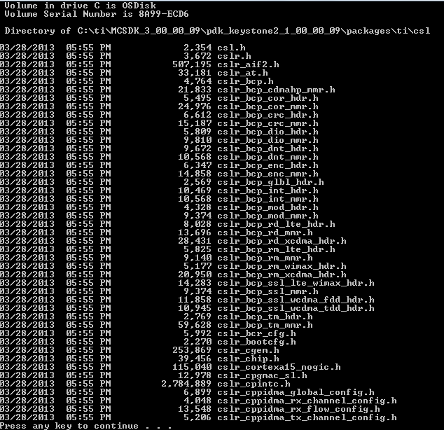
Partial List of CSL Include Files

Slide 34
DSP CorePac LLD Layer: Functions
KeyStone II Peripherals and Coprocessors
Resource Management
DSP CorePac CSL Layer
DSP CorePac LLD Layer
LLD Functions
LLD Support in MCSDK 3.x
LLD Usage
NWAL
ARM Kernel Drivers
ARM-DSP Inter-Processor Communications

Slide 35
LLD Overview
Low Level Drivers (LLD) hide the details of CSL from the application.
Simple IP and peripherals do not have LLD. The application uses CSL directly.
Most of the IPs use LLD.
Drivers for Linux system will be discussed later.

Slide 36
KeyStone I: Interface via LLD and CSL Layers

Slide 37
Understanding the LLD
Almost all LLDs are part of the Platform Development Kit (PDK), which is part of MCSDK.
EDMA LLD is not part of PDK
The Real Time Software Component (RTSC) system enforces a fix structure to all the LLD modules.
The lowest level of PDK functionality is CSL.
LLD drivers are the next layer above.
The next section addresses the LLDs that are part of the PDK for MCSDK release 3.x
Almost all LLD drivers are used the same way.

Slide 38
DSP CorePac LLD Layer: Support in MCSDK 3.x
KeyStone II Peripherals and Coprocessors
Resource Management
DSP CorePac CSL Layer
DSP CorePac LLD Layer
LLD Functions
LLD Support in MCSDK 3.x
LLD Usage
NWAL
ARM Kernel Drivers
ARM-DSP Inter-Processor Communications

Slide 39
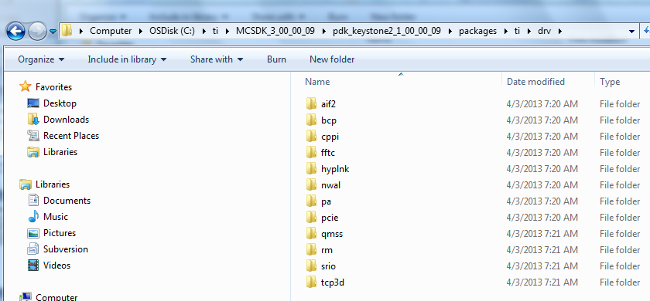
Supported LLD Drivers: MCSDK 3.0

Slide 40
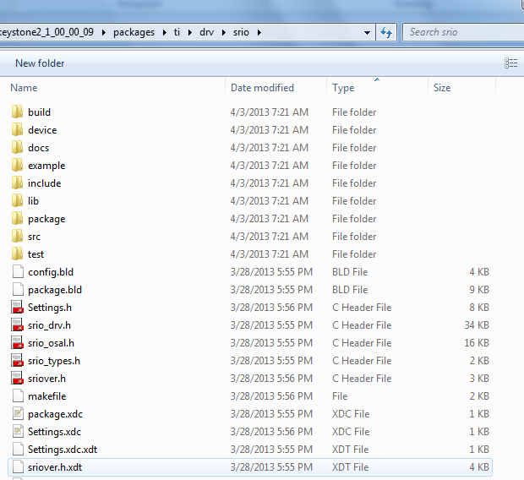
Directory
Structure of
LLD Drivers
(1/3)

Slide 41
Directory Structure of LLD Drivers (2/3)
Top directory
Include files that are visible to the application
XDC files that help with building projects
Subdirectories:
Build: Make files to build the generic libraries
Device: Device specific source code, usually definition and device specific functions
Docs: The most important subdirectory, will be discussed later.
Example: Code to support the example project
Include: Include files that are needed for internal module build

Slide 42
Directory Structure of LLD Drivers (3/3)
Additional Subdirectories:
Lib: Contains two generic libraries; little endian or big endian version (the additional e means big endian)
Package: Files that are used during the automatic building of the module
SRC: Contains the source files that are not device dependent
Test: Contains files that are part of the example test

Slide 43
Docs Directory
In the top directory
Software manifest (licensing, export control, etc.)
Release notes
User Guide*
Other module-specific documents
Doxygen Subdirectory
Collection of linked HTML files generated from the source code that describe the module objects and functions
Easy navigation between different types of information
The main tool to understand how to use the module
* not all modules have a user guide

Slide 44
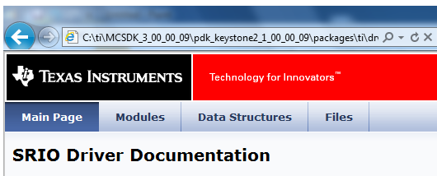
HTML Documents: Main Page

Slide 45
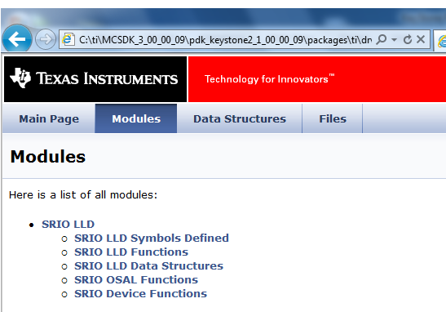
HTML Documents: Modules

Slide 46
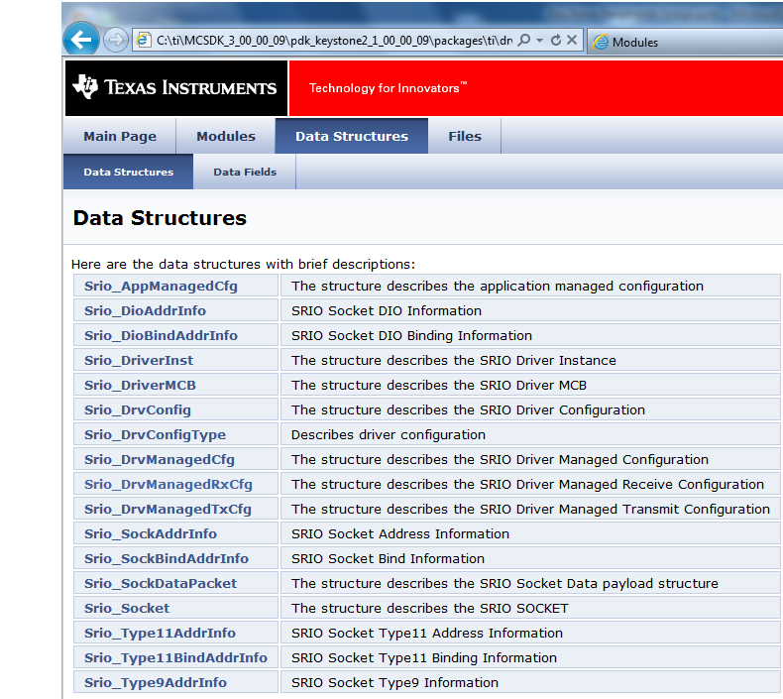
HTML Documents: Data Structures

Slide 47
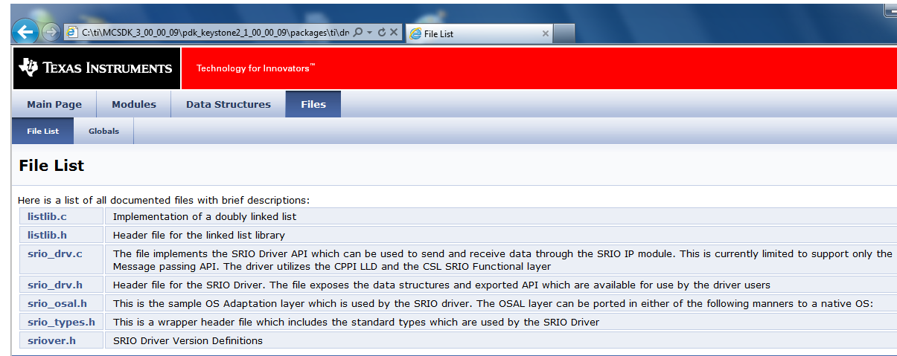
HTML Documents: Files

Slide 48
DSP CorePac LLD Layer: Usage
KeyStone II Peripherals and Coprocessors
Resource Management
DSP CorePac CSL Layer
DSP CorePac LLD Layer
LLD Functions
LLD Support in MCSDK 3.x
LLD Usage
NWAL
ARM Kernel Drivers
ARM-DSP Inter-Processor Communications

Slide 49
Developing LLD Code
Get a resource (open, create).
Resource management
Configure the resource (one core, each core).
Understand the structure of the parameters of the configuration function (example to follow)
Configure dependencies (Multicore Navigator).
Use in run time.
Follow the MCSDK example to understand what needs to be done (reverse engineer the C code).

Slide 50
PDK Example: Using SRIO Direct IO
if (coreNum == CORE_SYS_INIT)
{
System_printf ("Debug(Core %d): System Initialization for CPPI & QMSS\n", coreNum);
/* System Initialization */
if (system_init() < 0)
return;
/* Power on SRIO peripheral before using it */
if (enable_srio () < 0)
{
System_printf ("Error: SRIO PSC Initialization Failed\n");
return;
}
/* Device Specific SRIO Initializations: This should always be called before
* initializing the SRIO Driver. */
if (SrioDevice_init() < 0)
return;
/* Initialize the SRIO Driver */
if (Srio_init () < 0)
{
System_printf ("Error: SRIO Driver Initialization Failed\n");
return;
}

Slide 51
QMSS Example: Inside qmss_init
/* Initialize Queue Manager Sub System */
result = Qmss_init (&qmssInitConfig, &qmssGblCfgParams);
if (result != QMSS_SOK)
{
System_printf ("Error initializing Queue Manager SubSystem error code : %d\n", result);
return -1;
}
/* Start the QMSS. */
if (Qmss_start() != QMSS_SOK)
{
System_printf ("Error: Unable to start the QMSS\n");
return -1;
}
/* Memory Region 0 Configuration */
memRegInfo.descBase = (UInt32 *)l2_global_address((UInt32)host_region);
memRegInfo.descSize = SIZE_HOST_DESC;
memRegInfo.descNum = NUM_HOST_DESC;
memRegInfo.manageDescFlag = Qmss_ManageDesc_MANAGE_DESCRIPTOR;
memRegInfo.memRegion = Qmss_MemRegion_MEMORY_REGION_NOT_SPECIFIED;
/* Initialize and inset the memory region. */
result = Qmss_insertMemoryRegion (&memRegInfo);

Slide 52
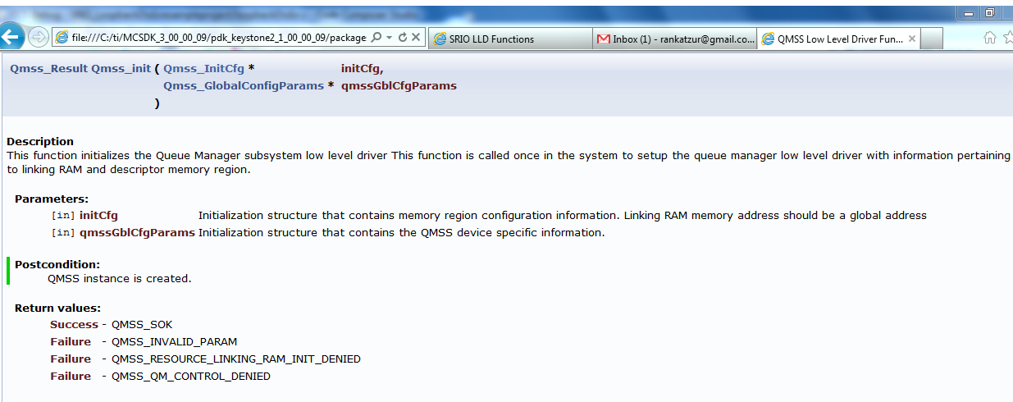
Locate qmss_init in Doc Directory (QMSS)

Slide 53
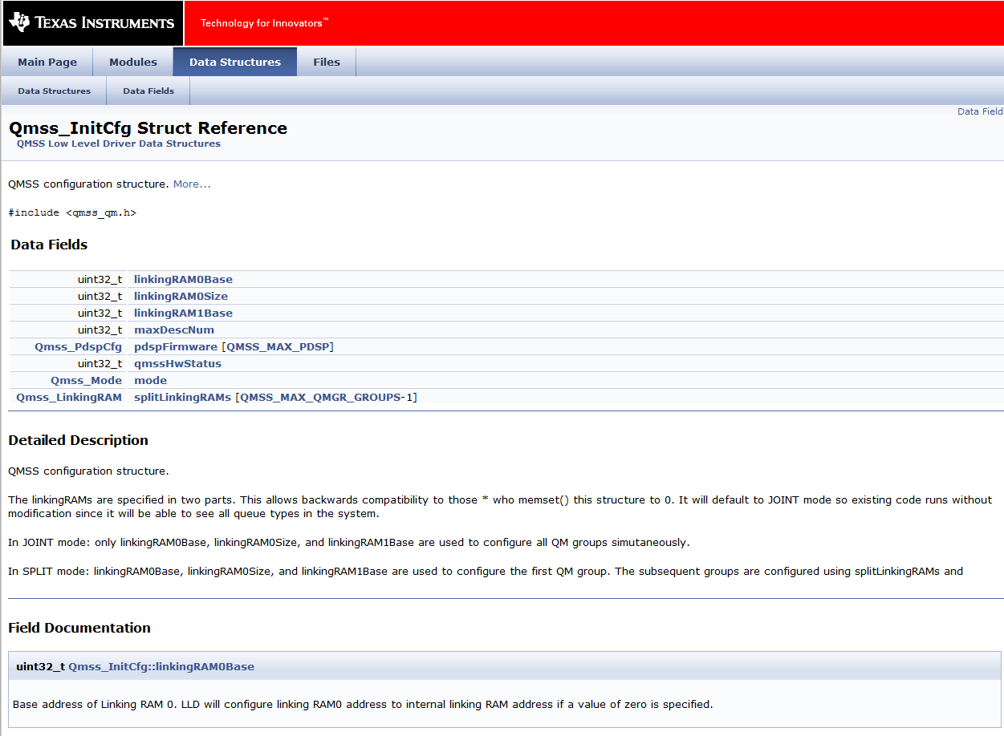
Qmss_InitCfg Struc Reference

Slide 54
Enable SRIO
static Int32 enable_srio (void)
{
/* SRIO power domain is turned OFF by default. It needs to be turned on before doing any
* SRIO device register access. This not required for the simulator. */
/* Set SRIO Power domain to ON */
CSL_PSC_enablePowerDomain (CSL_PSC_PD_SRIO);
/* Enable the clocks too for SRIO */
CSL_PSC_setModuleNextState (CSL_PSC_LPSC_SRIO, PSC_MODSTATE_ENABLE);
/* Start the state transition */
CSL_PSC_startStateTransition (CSL_PSC_PD_SRIO);
/* Wait until the state transition process is completed. */

Slide 55
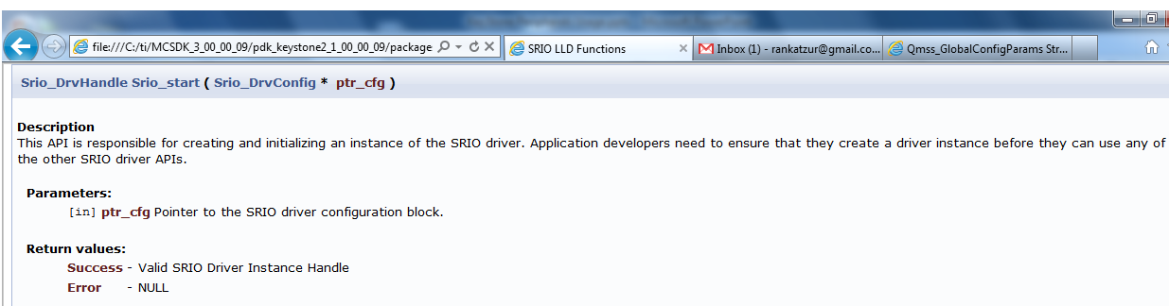
SRIO Handle to the Instance
hDrvManagedSrioDrv = Srio_start(&drvCfg);

Slide 56
DSP CorePac LLD Layer: NWAL
KeyStone II Peripherals and Coprocessors
Resource Management
DSP CorePac CSL Layer
DSP CorePac LLD Layer
LLD Functions
LLD Support in MCSDK 3.x
LLD Usage
NWAL
ARM Kernel Drivers
ARM-DSP Inter-Processor Communications

Slide 57
NETCP Configuration
NETCP is very sophisticated device that can offload all networking processing from CPU, but requires (of course) configuration.
The DSP LLD does not hide all implementation details from the application; They require multiple LLD calls and explicit usage of Multicore Navigator to configure the NETCP.
NWAL (Network Adaptation Layer) is higher layer driver library for easy configuration of the NETCP device.
NETAPI is a user’s space library that supports networking.

Slide 58
NWAL
The Network Adaptation Layer (NWAL) provides high-level driver functionality abstracting NETCP LLD for PA and SA.
NWAL supports NETCP functionality:
Classification and routing of ingress packages based on L2 (MAC), L3 (IP) and L4 (UDP - port) or L5 (GTPU ID)
MAC/IPSec/IP/UDP header generation for outgoing packets
NWAL APIs provide both blocking/synchronous and non-blocking/asynchronous support for the NETCP configuration.
NWAL is part of PDK release.

Slide 59
NWAL: NETCP Security Accelerator (SA) Configuration
Unidirectional IPSec SA creation and deletion
Unidirectional IPSec Security Policy creation and deletion

Slide 60
NWAL Dependencies
Initialization of Queue Manager Subsystem (QMSS)
Initialization of memory buffer pool with packet DMA resources including descriptors

Slide 61
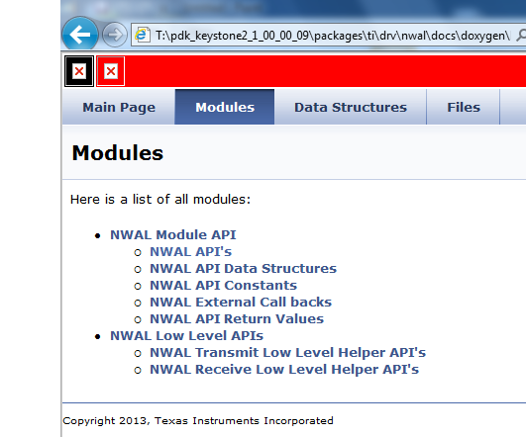
NWAL Documentation - T:\pdk_keystone2_1_00_00_09\packages\ti\drv\nwal\docs\doxygen\html

Slide 62
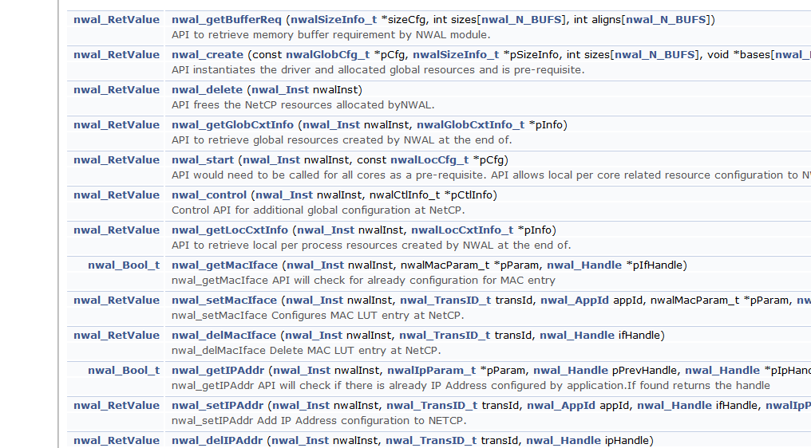
NWAL Functions (Partial List)

Slide 63
ARM Kernel Drivers
KeyStone II Peripherals and Coprocessors
Resource Management
DSP CorePac CSL Layer
DSP CorePac LLD Layer
LLD Functions
LLD Support in MCSDK 3.x
LLD Usage
NWAL
ARM Kernel Drivers
ARM-DSP Inter-Processor Communications

Slide 64
What About Linux?
Device Tree and Resource Manager
Linux Device Driver
Modularity
Standard interface
Standard structure

Slide 65
What are Linux Device Drivers?
Link between standard interface and the hardware
Hides the complexity of device operation from the user
Provides standard API to use the device
Maps the API to one or more functions that manipulate the specific hardware device.
Linux kernel modularity scheme enables easy plugging of new device drivers to a kernel.

Slide 66
Linux Application API
Device drivers can be loaded during boot time or loaded (as modules) during run time
Driver classification:
Character device
Block device
Network interface
Each type of drivers have standard API, for example, character devices will have open and close, read and write functions.

Slide 67
KeyStone Drivers Structure Example - SRIO

Slide 68
Linux Drivers mcsdk_03_00_00_09/linux-keystone/drivers
GIC IRQ chip driver
Keystone IPC IRQ chip driver
AEMIF driver
NAND driver
SPI and SPI NOR flash drivers
I2C and EEPROM drivers
Keystone GPIO driver
Keystone IPC GPIO driver
Network driver (NetCP), PktDMA, Packet Accelerator
SGMII driver
QoS driver
USB driver
10Gig Ethernet driver (not validated due to test hardware)
PCIe driver

Slide 69
ARM-DSP Inter-Processor Communications
KeyStone II Peripherals and Coprocessors
Resource Management
DSP CorePac CSL Layer
DSP CorePac LLD Layer
LLD Functions
LLD Support in MCSDK 3.x
LLD Usage
NWAL
ARM Kernel Drivers
ARM-DSP Inter-Processor Communications

Slide 70
User Space Libraries
Part of the MCSDK release
Set of libraries:
IPC: Communication between cores (ARM to DSP, between DSP, between devices)
MSGCOM : An IPC mechanism to communicate between cores (either C66x or ARM)
Ethernet Driver

Slide 71
IPC Scenarios
Data Plane
Fast Path
Data Plane
Non Fast Path
Control
Path
Data Plane
Fast Path
Control
Path
Data Plane
Non Fast Path
Control
Path
PKT I/O
MSGCOM
IPC 3.x
msgQ
PKT I/O
IPC 3.x
msgQ
MSGCOM
IPC 3.x
msgQ
QMLLD
QMLLD
QMLLD
Socket
Socket
VirtIO
VirtIO
VirtIO
vEth
vEth
UDMA
Eth
Eth
A15
A15
DSP
User Space
Transport Net Lib
IPC Deliverables
API Bindings
Linux/Kernel
PDK Deliverables
Data Flow

Slide 72
IPC Services
The IPC package is a set of APIs
MessageQ uses the modules below …
But each module can also be used independently.
Application

Slide 73
Using MessageQ (1/3)
CorePac 2 - READER
MessageQ_create(“myQ”, *synchronizer);
MessageQ_get(“myQ”, &msg, timeout);
“myQ”
MessageQ transactions begin with READER creating a MessageQ.
READER’s attempt to get a message results in a block (unless timeout was specified), since no messages are in the queue yet.
What happens next?

Slide 74
Using MessageQ (2/3)
CorePac 1 - WRITER
CorePac 2 - READER
MessageQ_open (“myQ”, …);
msg = MessageQ_alloc (heap, size,…);
MessageQ_put(“myQ”, msg, …);
MessageQ_create(“myQ”, …);
MessageQ_get(“myQ”, &msg…);
“myQ”
Heap
WRITER begins by opening MessageQ created by READER.
WRITER gets a message block from a heap and fills it, as desired.
WRITER puts the message into the MessageQ.
How does the READER get unblocked?

Slide 75
Using MessageQ (3/3)
CorePac 1 - WRITER
CorePac 2 - READER
MessageQ_open (“myQ”, …);
msg = MessageQ_alloc (heap, size,…);
MessageQ_put(“myQ”, msg, …);
MessageQ_close(“myQ”, …);
MessageQ_create(“myQ”, …);
MessageQ_get(“myQ”, &msg…);
*** PROCESS MSG ***
MessageQ_free(“myQ”, …);
MessageQ_delete(“myQ”, …);
“myQ”
Heap
Once WRITER puts msg in MessageQ, READER is unblocked.
READER can now read/process the received message.
READER frees message back to Heap.
READER can optionally delete the created MessageQ, if desired.

Slide 76
MsgCom Library
Purpose: To exchange messages between a reader and writer.
Read/write applications can reside:
On the same DSP core
On different DSP cores
On both the ARM and DSP core
Channel and Interrupt-based communication:
Channel is defined by the reader (message destination) side
Supports multiple writers (message sources)

Slide 77
Channel Types
Simple Queue Channels: Messages are placed directly into a destination hardware queue that is associated with a reader.
Virtual Channels: Multiple virtual channels are associated with the same hardware queue.
Queue DMA Channels: Messages are copied using infrastructure PKTDMA between the writer and the reader.
Proxy Queue Channels – Indirect channels work over BSD sockets; Enable communications between writer and reader that are not connected to the same Navigator.

Slide 78
Interrupt Types
No interrupt: Reader polls until a message arrives.
Direct Interrupt: Low-delay system; Special queues must be used.
Accumulated Interrupts: Special queues are used; Reader receives an interrupt when the number of messages crosses a defined threshold.

Slide 79
Blocking and Non-Blocking
Blocking: The Reader can be blocked until message is available.
Non-blocking: The Reader polls for a message. If there is no message, it continues execution.

Slide 80
Case 1: Generic Channel Communication Zero Copy-based Constructions: Core-to-Core
NOTE: Logical function only
hCh=Find(“MyCh1”);
hCh = Create(“MyCh1”);
Reader
Writer
MyCh1
Tibuf *msg = PktLibAlloc(hHeap);
Put(hCh,msg);
Tibuf *msg =Get(hCh);
PktLibFree(msg);
Delete(hCh);
Reader creates a channel ahead of time with a given name (e.g., MyCh1).
When the Writer has information to write, it looks for the channel (find).
Writer asks for a buffer and writes the message into the buffer.
Writer does a “put” to the buffer. The Navigator does it – magic!
When the Reader calls “get,” it receives the message.
The Reader must “free” the message after it is done reading.
Notes:
Notes:
All naming is illustrative.
Open Items:
Recycling policies on Tx Completion queues
API Naming convention

Slide 81
Case 2: Low-Latency Channel Communication Single and Virtual Channel Zero Copy-based Construction: Core-to-Core
NOTE: Logical function only
Reader
Writer
hCh = Create(“MyCh2”);
MyCh2
Posts internal Sem and/or callback posts MySem;
hCh=Find(“MyCh2”);
chRx
(driver)
Get(hCh); or Pend(MySem);
Tibuf *msg = PktLibAlloc(hHeap);
Put(hCh,msg);
PktLibFree(msg);
hCh=Find(“MyCh3”);
MyCh3
hCh = Create(“MyCh3”);
Tibuf *msg = PktLibAlloc(hHeap);
Get(hCh); or Pend(MySem);
Put(hCh,msg);
PktLibFree(msg);
Reader creates a channel based on a pending queue. The channel is created ahead of time with a given name (e.g., MyCh2).
Reader waits for the message by pending on a (software) semaphore.
When Writer has information to write, it looks for the channel (find).
Writer asks for buffer and writes the message into the buffer.
Writer does a “put” to the buffer. The Navigator generates an interrupt . The ISR posts the semaphore to the correct channel.
The Reader starts processing the message.
Virtual channel structure enables usage of a single interrupt to post semaphore to one of many channels.
Notes:
Notes:
All naming is illustrative.
Open Items:
Recycling policies on Tx Completion queues
API Naming convention

Slide 82
Case 3: Reduce Context Switching Zero Copy-based Constructions: Core-to-Core
NOTE: Logical function only
Reader
Writer
hCh = Create(“MyCh4”);
hCh=Find(“MyCh4”);
MyCh4
Tibuf *msg =Get(hCh);
Tibuf *msg = PktLibAlloc(hHeap);
chRx
(driver)
Put(hCh,msg);
Accumulator
PktLibFree(msg);
Delete(hCh);
Reader creates a channel based on an accumulator queue. The channel is created ahead of time with a given name (e.g., MyCh4).
When Writer has information to write, it looks for the channel (find).
Writer asks for buffer and writes the message into the buffer.
The writer put the buffer. The Navigator adds the message to an accumulator queue.
When the number of messages reaches a water mark, or after a pre-defined time out, the accumulator sends an interrupt to the core.
Reader starts processing the message and makes it “free” after it is done.
Notes:
Notes:
All naming is illustrative.
Open Items:
Recycling policies on Tx Completion queues
API Naming convention

Slide 83
Case 4: Generic Channel Communication ARM-to-DSP Communications via Linux Kernel VirtQueue
NOTE: Logical function only
Reader
Writer
hCh = Create(“MyCh5”);
hCh=Find(“MyCh5”);
MyCh5
msg = PktLibAlloc(hHeap);
Tibuf *msg =Get(hCh);
Put(hCh,msg);
Tx
PKTDMA
Rx
PKTDMA
PktLibFree(msg);
Delete(hCh);
Reader creates a channel ahead of time with a given name (e.g., MyCh5).
When the Writer has information to write, it looks for the channel (find). The kernel is aware of the user space handle.
Writer asks for a buffer. The kernel dedicates a descriptor to the channel and provides the Writer with a pointer to a buffer that is associated with the descriptor. The Writer writes the message into the buffer.
Writer does a “put” to the buffer. The kernel pushes the descriptor into the right queue. The Navigator does a loopback (copies the descriptor data) and frees the Kernel queue. The Navigator loads the data into another descriptor and sends it to the appropriate core.
When the Reader calls “get,” it receives the message.
The Reader must “free” the message after it is done reading.
Notes:
Notes:
All naming is illustrative.
Open Items:
Recycling policies on Tx Completion queues
API Naming convention

Slide 84
Case 5: Low-Latency Channel Communication ARM-to-DSP Communications via Linux Kernel VirtQueue
NOTE: Logical function only
hCh = Create(“MyCh6”);
Reader
Writer
MyCh6
hCh=Find(“MyCh6”);
chIRx
(driver)
Get(hCh); or Pend(MySem);
msg = PktLibAlloc(hHeap);
Put(hCh,msg);
Tx
PKTDMA
Rx
PKTDMA
PktLibFree(msg);
Delete(hCh);
PktLibFree(msg);
Reader creates a channel based on a pending queue. The channel is created ahead of time with a given name (e.g., MyCh6).
Reader waits for the message by pending on a (software) semaphore.
When Writer has information to write, it looks for the channel (find). The kernel space is aware of the handle.
Writer asks for buffer. The kernel dedicates a descriptor to the channel and provides the Writer with a pointer to a buffer that is associated with the descriptor. The Writer writes the message into the buffer.
Writer does a “put” to the buffer. The kernel pushes the descriptor into the right queue. The Navigator does a loopback (copies the descriptor data) and frees the Kernel queue. The Navigator loads the data into another descriptor, moves it to the right queue, and generates an interrupt. The ISR posts the semaphore to the correct channel
Reader starts processing the message.
Virtual channel structure enables usage of a single interrupt to post semaphore to one of many channels.
Notes:
Notes:
All naming is illustrative.
Open Items:
Recycling policies on Tx Completion queues
API Naming convention

Slide 85
Case 6: Reduce Context Switching ARM-to-DSP Communications via Linux Kernel VirtQueue
NOTE: Logical function only
hCh=Find(“MyCh7”);
hCh = Create(“MyCh7”);
Reader
Writer
MyCh7
Msg = Get(hCh);
chRx
(driver)
msg = PktLibAlloc(hHeap);
Put(hCh,msg);
Tx
PKTDMA
Rx
PKTDMA
Accumulator
PktLibFree(msg);
Delete(hCh);
Reader creates a channel based on one of the accumulator queues. The channel is created ahead of time with a given name (e.g., MyCh7).
When Writer has information to write, it looks for the channel (find). The Kernel space is aware of the handle.
The Writer asks for a buffer. The kernel dedicates a descriptor to the channel and gives the Write a pointer to a buffer that is associated with the descriptor. The Writer writes the message into the buffer.
The Writer puts the buffer. The Kernel pushes the descriptor into the right queue. The Navigator does a loopback (copies the descriptor data) and frees the Kernel queue. Then the Navigator loads the data into another descriptor. Then the Navigator adds the message to an accumulator queue.
When the number of messages reaches a watermark, or after a pre-defined time out, the accumulator sends an interrupt to the core.
Reader starts processing the message and frees it after it is complete.
Notes:
Notes:
All naming is illustrative.
Open Items:
Recycling policies on Tx Completion queues
API Naming convention

Slide 86
Code Example
Reader
hCh = Create(“MyChannel”, ChannelType, struct *ChannelConfig); // Reader specifies what channel it wants to create
// For each message
Get(hCh, &msg) // Either Blocking or Non-blocking call,
pktLibFreeMsg(msg); // Not part of IPC API, the way reader frees the message can be application specific
Delete(hCh);
Writer:
hHeap = pktLibCreateHeap(“MyHeap); // Not part of IPC API, the way writer allocates the message can be application specific
hCh = Find(“MyChannel”);
//For each message
msg = pktLibAlloc(hHeap); // Not part of IPC API, the way reader frees the message can be application specific
Put(hCh, msg); // Note: if Copy=PacketDMA, msg is freed my Tx DMA.
…
msg = pktLibAlloc(hHeap); // Not part of IPC API, the way reader frees the message can be application specific
Put(hCh, msg);

Slide 87
Backup – PktLib Utility Libraries

Slide 88
Packet Library (PktLib)
Purpose: High-level library to allocate packets and manipulate packets used by different types of channels.
Enhance capabilities of packet manipulation
Enhance Heap manipulation

Slide 89
Heap Allocation
Heap creation supports shared heaps and private heaps.
Heap is identified by name. It contains Data buffer Packets or Zero Buffer Packets
Heap size is determined by application.
Typical pktlib functions:
Pktlib_createHeap
Pktlib_findHeapbyName
Pktlib_allocPacket

Slide 90
Packet Manipulations
Merge multiple packets into one (linked) packet
Clone packet
Split Packet into multiple packets
Typical pktlib functions:
Pktlib_packetMerge
Pktlib_clonePacket
Pktlib_splitPacket

Slide 91
PktLib: Additional Features
Clean up and garbage collection (especially for clone packets and split packets)
Heap statistics
Cache coherency

Slide 92
For More Information
Software downloads and device-specific Data Manuals for the KeyStone II SoCs can be found at TI.com/multicore.
For articles related to multicore software and tools, refer to the Embedded Processors Wiki for the KeyStone Device Architecture.
For questions regarding topics covered in this training, visit the support forums at the TI E2E Community website.

